Slide 1
An Income Tax Fraud Detection Idea using AI & ML
PIP2001 Capstone Project
VIVA-VOCE
Batch Number: CSE-G106
Roll Number | Student Name
20211CSE0591 | Mohan R Shetty
20211CSE0584 | Amulya S Sathish
20211CSE0599 | Suchithra K
20211CSE0607 | Sumanth R
Under the Supervision of,
Ms. Vineetha
Assistant Professor
School of Computer Science and Engineering
Presidency University
Name of the Program: CSE
Name of the HoD: Dr. Asif Mohammed H.B
Name of the Program Project Coordinator: Mr. Amarnath J.L
Name of the School Project Coordinators: Dr. Sampath A K

Slide 2
Introduction
Tax paying is a important entity that a citizen should pay a particular amount to the government, and the amount is decided according to one’s income and other background information. In the current situation , not every tax payer is being truthful and paying the amount. Few people do not hand in the proper income information to the government which they earn in the yearly basis. They show false income to the government and pays less tax amount which is not so legal. The main purpose of this model is to identify the customers who have not given proper information and detecting the fraud being done through AIML technique.

Slide 3
Literature Review
A Machine Learning-based System for Financial Fraud Detection
https://www.researchgate.net/publication/357293068_A_Machine_Learning-based_System_for_Financial_Fraud_Detection
Assessing the Role of Artificial Intelligence (AI) on Tax Fraud Detection
https://www.researchgate.net/publication/383570753_Assessing_the_Role_of_Artificial_Intelligence_AI_on_Tax_Fraud_Detection
Enhanced Income Tax Fraud Detection System Using Machine Learning
https://www.researchgate.net/publication/379861359_Enhanced_Income_Tax_Fraud_Detection_System_Using_Machine_Learning
AI-Driven Approaches for Real-Time Fraud Detection in US Financial Transactions: Challenges and Opportunities
https://www.researchgate.net/publication/381548442_AI-Driven_Approaches_for_RealTime_Fraud_Detection_in_US_Financial_Transactions_Challenges_and_Opportunities

Slide 4
Existing method Drawback
1. Limited Accuracy: Existing methodologies fail to accurately detect fraudulent tax filings .
2. Failure to address emerging new fraud patterns: The current system lacks adaptability to new fraud patterns, leading to vulnerabilities in fraud detection.
3. Resource Intensiveness: Implementing data normalization and an algorithm
requires significant computational resources.

Slide 5
Proposed Method
1.Improved Accuracy: The algorithms enhance the accuracy of fraud detection, providing a more reliable mechanism for identifying potential instances of income tax fraud.
2. Adaptability to new fraud models: The proposed system can adapt to emerging fraud models, enabling continuous improvement in fraud detection.
3. Automation: By automating the detection process and optimizing performance metrics, the system improves efficiency in identifying fraudulent tax filings.
4. Enhanced Efficiency: The proposed system enhances efficiency by automating the fraud detection process and streamlining decision-making.

Slide 6
Objectives
Some main objectives of this model are:
Automating fraud detection processes
Detecting real-time fraud
Strengthening tax department
Identifying fraudulent patterns
Improved Accuracy in Identifying Tax Evasion
Cost Savings for the Government

Slide 7
Methodology/Modules
The implementation of this model typically follows a structured framework, starting from data collection to the final deployment of the model for fraud detection.
Data Collection and Preprocessing
Analyzing data
Model Selection
Web Interface
Backend development with flask
Testing and deployment

Slide 8
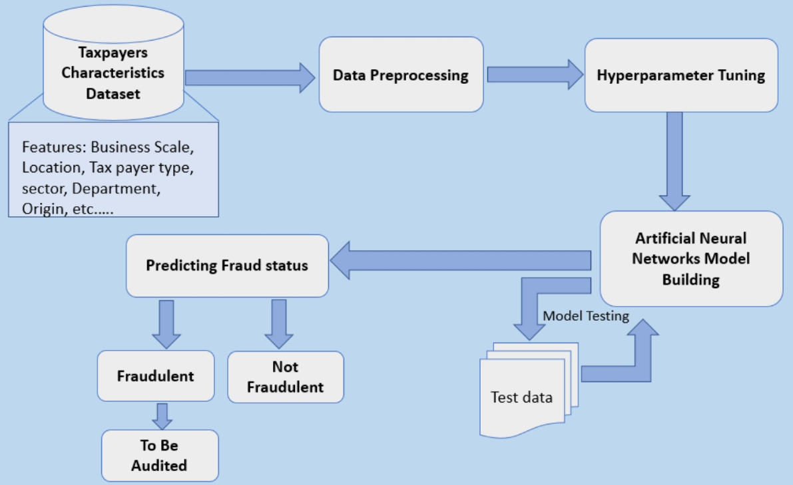
Architecture
Random Forest algorithm

Slide 9
Hardware/software components
Operating System : Windows/ mac
Python (Concepts related to data science )
IDE : Colab , VS Code

Slide 10
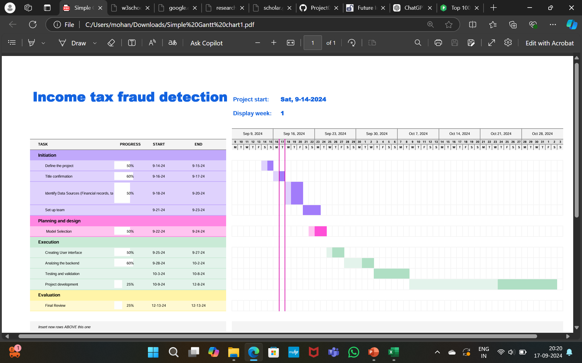
Timeline of Project

Slide 11
Expected Outcomes
Tax frauds are detected, if there is any misleading in the given details and by this technique frauds ratio will reduce.
Collection of tax with the proper information and the revenue will also increase accordingly.
Enhanced Transparency and Fairness is maintained in order be consistent and fair to all tax payers.
Cost reduction will also play a major role through this model. As it reduce the expense, if there is any field investigation to detect any scam.
Auditing of tax will not take more time and details will be validated immediately.

Slide 12
Conclusion
The implementation of AI and ML for income tax fraud detection represents a significant improvement toward modernizing the country’s tax administration system. By implementing advanced data analysis and predictive modeling, the system can detect tax fraud with greater accuracy, speed, and efficiency. This approach not only reduces manual workloads for tax authorities but also curbs tax evasion through real-time monitoring and early intervention.
This model helps in detecting various fraud patterns, which also helps the tax department to ensure all the tax related works and operations are done properly without any misguidance.
Overall, this model can contribute to a stronger, more stable national economy by ensuring that due taxes are collected effectively.

Slide 13
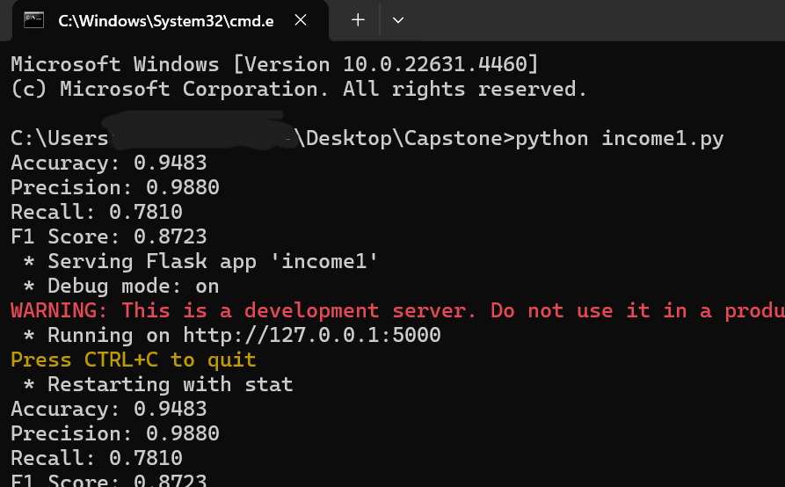

Results:

Slide 14
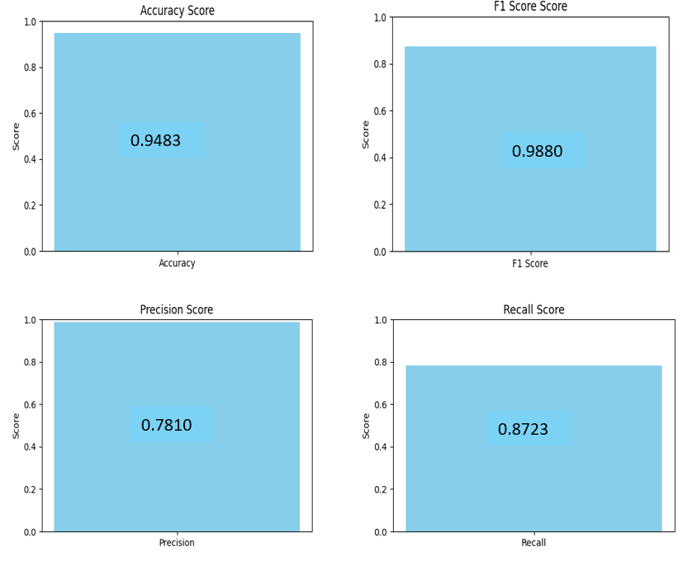
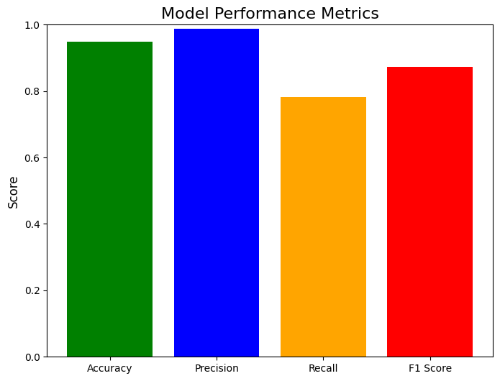

Slide 15
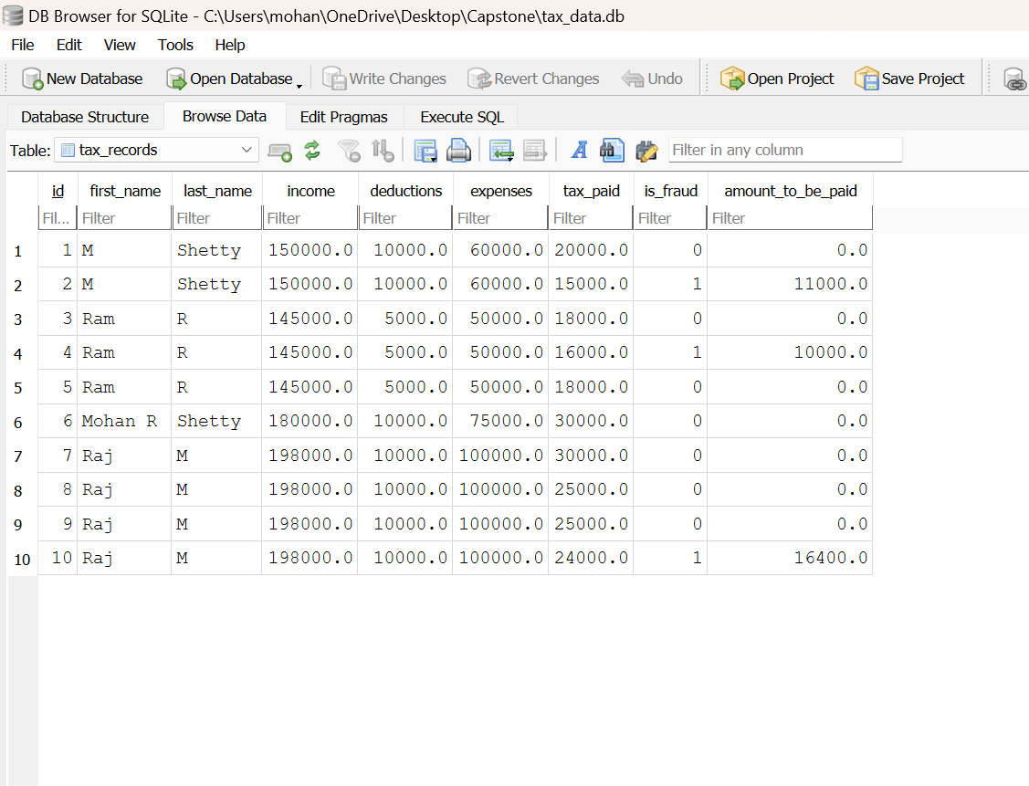

Slide 16
Github Link
The Github link provided should have public access permission.
Github Link
https://github.com/Capstone106/Project106.git

Slide 17
References
Enhanced Income Tax Fraud Detection System Using Machine Learning
Dr RM Rani 1, Amrit Anand 2, Pratham Agarwal 3, Ayush Srivastava 4 Assistant Professor 1 UG Student1 2 3, Department of Information Technology SRM Institute of Science and Technology, Ramapuram, Chennai, ranir@srmist.edu.in 1,aa5298@srmist.edu.in 2,pa3753@srmist.edu.in 3,ar7692@srmist.edu.in .
Financial Fraud Detection Based on Machine Learning: A Systematic Literature Review Abdulalem Ali 1, *, Shukor Abd Razak 1, 2, * , Siti Hajar Othman 1, Taiseer Abdalla Elfadil Eisa 3,Arafat Al-Dhaqm 1, * , Maged Nasser
Tax Fraud Detection through Neural Networks: An Application Using a Sample of Personal Income Taxpayers
Fraud Detection Using Neural Networks: A Case Study of Income Tax
Tax evasion risk management using a Hybrid Unsupervised Outlier Detection method

Slide 18
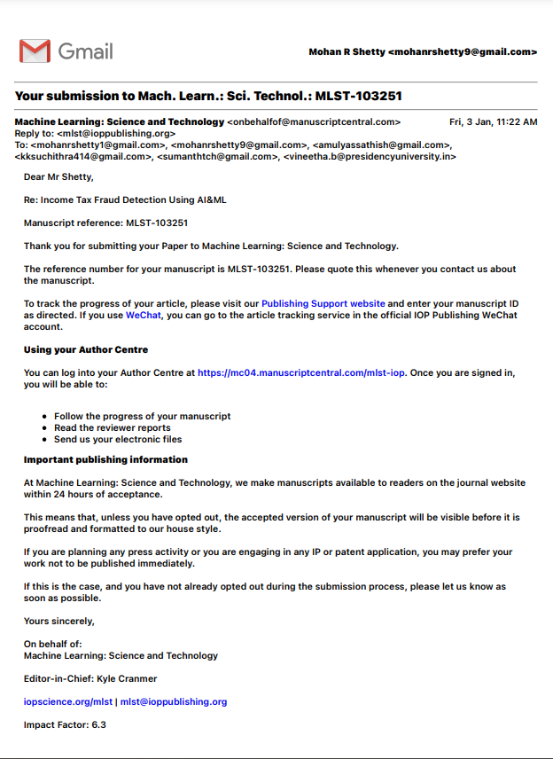
Publication Details:

Slide 19

Project work mapping with SDG
^{16th} goal maps with our project.ie Peace, Justice and Strong Institutions.

Slide 20
Thank You

